Slide 1

Customer churn prediction

Slide 2


Team Introduction
TEAM MAATHAI
Oyelayo Seye

Slide 3
Presentation plan
Motivation
Project Goal
Data Gathering
Data Exploration
Data Cleaning and Preprocessing
Encoding
Oversampling
Features Selection
Deployment

Slide 4

Motivation
Measuring growth is a crucial aspect for organizations to assess their performance and sustainability. These two dimensions:
Customer Retention
Customer Acquisition

Slide 5
Project goal
Our main goal for this project is to use machine learning to predict customer churn, the metric used for gauging customer retention.
In order to address this issue, we have obtained a dataset from Kaggle that contains information about 10,127 customers, including their age, salary, marital status, credit card limit, credit card category, and other related features.

Slide 6
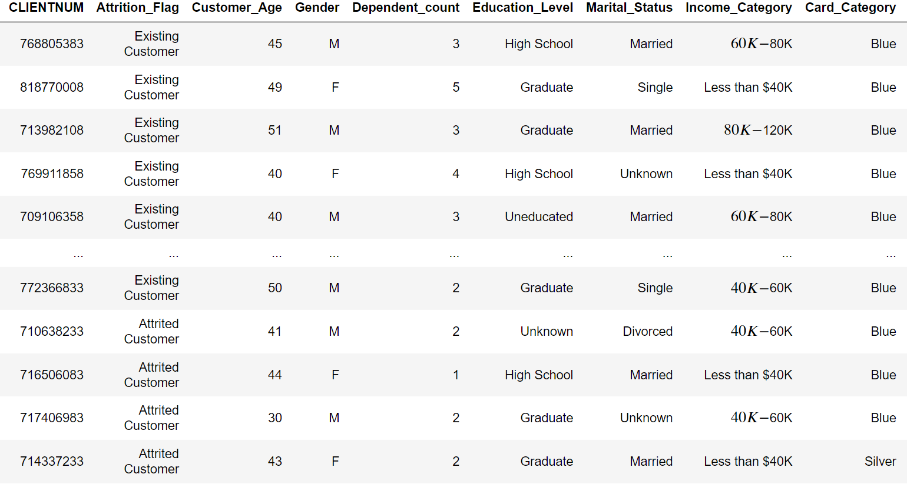
Data Gathering
As mentioned earlier, we got our dataset from Kaggle.

Slide 7
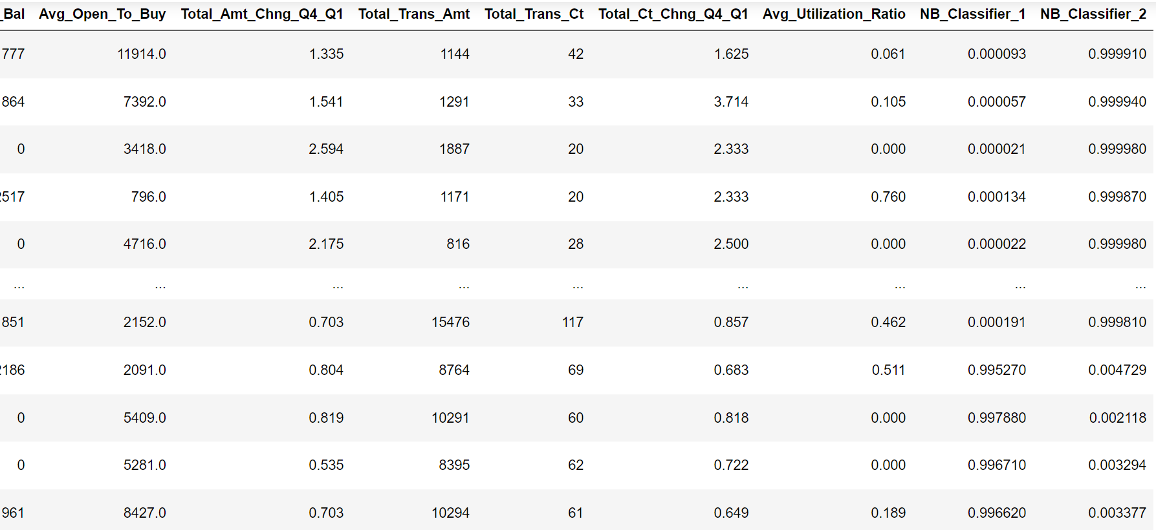

Slide 8
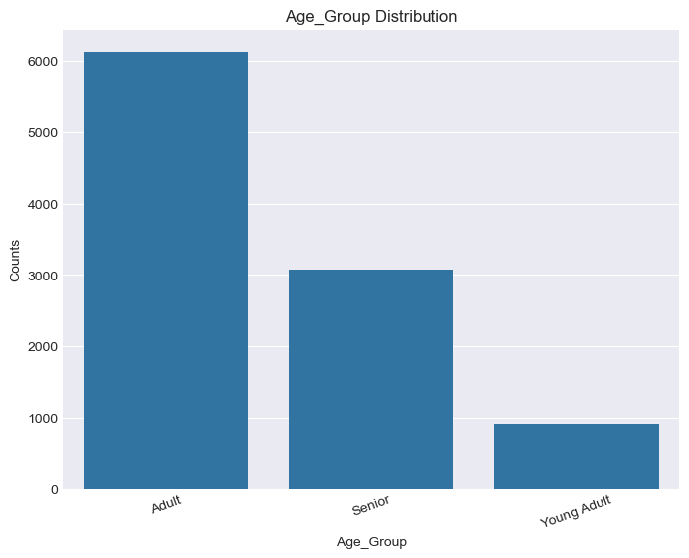
Data Exploration

Slide 9
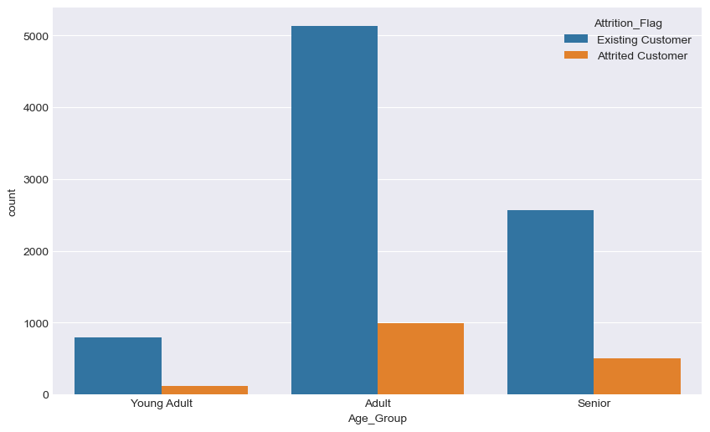

Slide 10
Data Cleaning and Preprocessing
Renaming of long column names to shorten their names and for proper tabular structure.
Removal of outliers
Rescaling
Normalization

Slide 11
Encoding
Encoding categorical data such as gender
Encoding ordinal data such as education level, marital status,
income category', card category

Slide 12
Oversampling Technique
Our data was highly imbalanced, with the existing customer class approximately 5% higher than the attrited customer class.
SMOTE was used to perform oversampling to scale up the attrited customer class.

Slide 13
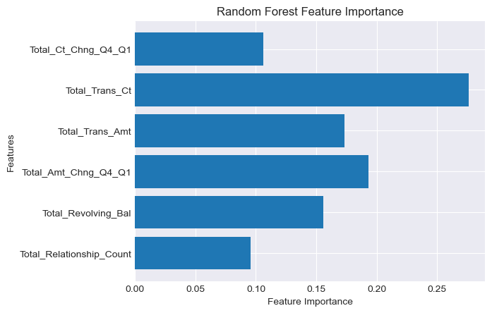
Features Selection

Slide 14
Features Selection Continuation
Multicollinearity: Multicollinearity is a statistical phenomenon that occurs when two or more independent variables in a regression model are highly correlated.
Recursive features Elimination: Recursive Feature Elimination (RFE) is a feature selection technique used in machine learning to systematically remove less important features from a model, iteratively improving the model's performance.

Slide 15
K-fold Cross Validation
We used k-fold cross-validation for our validation set, where different algorithms were tested to select the algorithm that best exposes the underlying patterns. After testing different algorithms, the random forest classifier gave us the best result, achieving an accuracy of 95% with a standard deviation of 0.0077.

Slide 16
Test Data
On our test data, we achieved an accuracy of 85% using the Random Forest classifier with only 6 important features. Additionally, we obtained a 77% accuracy using the Ridge classifier with the same set of 6 important features.

Slide 17
Deployment
During deployment, we employed both the Random Forest classifier and the Ridge classifier to leverage the strengths of each algorithm. Streamlit was used as the deployment platform for our model.

Slide 18
Application Demonstration

